Slide 1
Conditional Programming constructs
One of the more powerful features that procedural blocks provide in Verilog is the ability to use conditional programming constructs such as if-else decisions, case statements, and loops.
These constructs are only available within a procedural block and can be used to model both combinational and sequential logic.

Slide 2
if-else Statements
An if-else statement provides a way to make conditional signal assignments based on Boolean conditions.
The if portion of statement is followed by a Boolean condition that if evaluated TRUE will cause the signal assignment listed after it to be performed.
If the Boolean condition is evaluated FALSE, the statements listed after the else portion are executed.
If multiple statements are to be executed in either the if or else portion, then the statement group keywords begin/end need to be used.
If only one statement is to be executed, then the statement group keywords are not needed.
The else portion of the statement is not required and if omitted, no assignment will take place when the Boolean condition is evaluated FALSE.

Slide 3
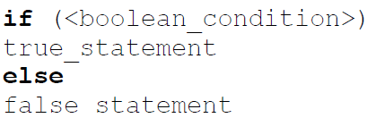
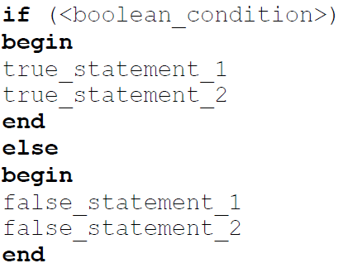
if-else Statements
Syntax for an if-else statement is as follows:
The syntax for an if-else statement with multiple true/false statements is as follows:

Slide 4
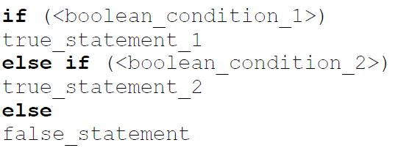
if-else Statements
If more than one Boolean condition is required, additional if-else statements can be embedded within the else clause of the preceding if statement. The following shows an example of if-else statements implementing two Boolean conditions.

Slide 5
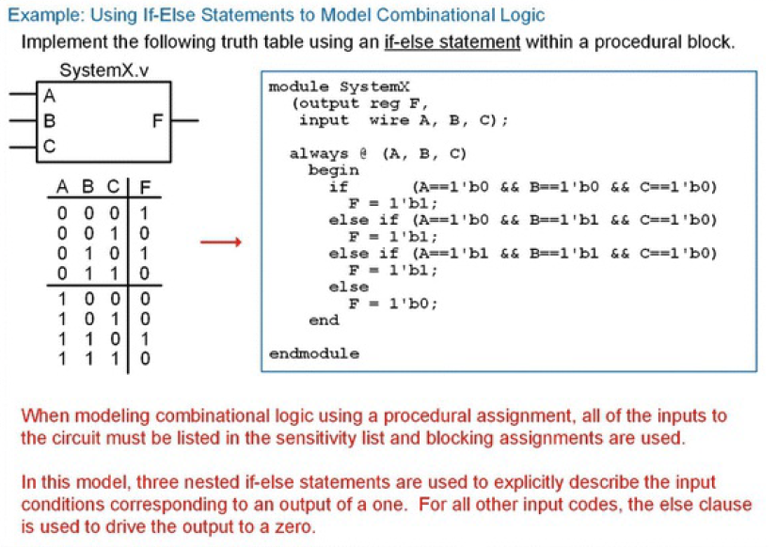

Slide 6
case Statements
A case statement is another technique to model signal assignments based on Boolean conditions.
A case statement can only be used inside of a procedural block.
The statement begins with the keyword case followed by the input signal name that assignments will be based off of enclosed within parenthesis.
The case statement can be based on multiple input signal names by concatenating the signals within the parenthesis.
Then a series of input codes followed by the corresponding assignment is listed.
The keyword default can be used to provide the desired signal assignment for any input codes not explicitly listed.
When multiple input conditions have the same assignment statement, they can be listed on the same line comma-delimited to save space.
The keyword endcase is used to denote the end of the case statement.

Slide 7
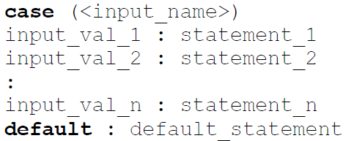

case Statements
The following is the syntax for a case statement.
If-else statements can be embedded within a case statement and, conversely, case statements can be embedded within an if-else statement.

Slide 8
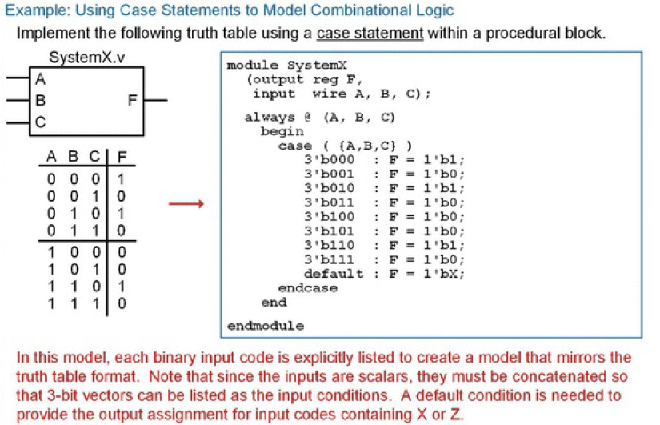

Slide 9
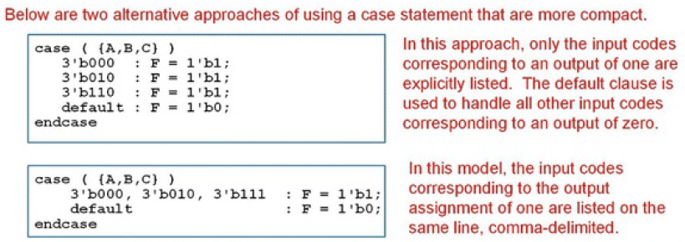

Slide 10
casez and casex Statements
Verilog provides two additional case statements that support don’t cares in the input conditions.
The casez statement allows the symbols? and Z to represent a don’t care.
The casex statement extends the casez statement by also interpreting X as a don’t care.
Care should be taken when using the casez and casex statement as it is easy to create unintended logic when using don’t cares in the input codes.

Slide 11
forever Loops
A loop within Verilog provides a mechanism to perform repetitive assignments infinitely. This is useful in test benches for creating stimulus such as clocks or other periodic signals.
All looping constructs must reside with a procedural block. The simplest looping construct is the forever loop.
As with other conditional programming constructs, if multiple statements are associated with the forever loop they must be enclosed within a statement group. If only one statement is used the statement group is not needed.
A forever loop within an initial block provides identical behavior as an always loop without a sensitivity loop.
It is important to provide a time step event or delay within a forever loop or it will cause a simulation to hang.

Slide 12
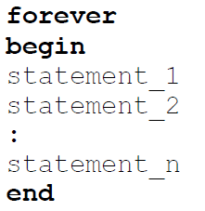
forever Loops
The following is the syntax for a forever loop in Verilog.
Consider the following example of a forever loop that generates a clock signal (CLK) with a period of 10 time units. In this example, the forever loop is embedded within an initial block. This allows the initial value of CLK to be set to zero upon the beginning of the simulation. Once the forever loop is entered, it will execute indefinitely.
Notice that since there is only one statement after the forever keyword, a statement group (i.e., begin/end) is not needed.
initial
begin
CLK = 0;
forever
#10 CLK = ~CLK;
end

Slide 13
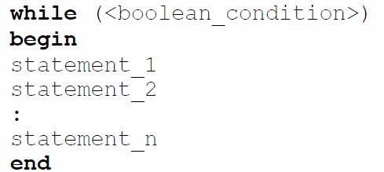
while Loops
A while loop provides a looping structure with a Boolean condition that controls its execution. The loop will only execute as long as the Boolean condition is evaluated true. The following is the syntax for a Verilog while loop.
The given example generates a clock signal (CLK) with a period of 10 time units as long as EN = 1. The TRUE Boolean condition for the while loop is EN = 1. When EN = 0, the while loop will be skipped. When the loop becomes inactive, CLK will hold its last assigned value.
Example
initial
begin
CLK = 0;
while (EN == 1)
#10 CLK = ~CLK;
end

Slide 14
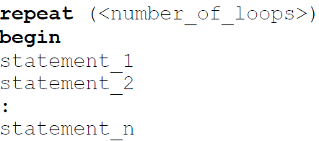
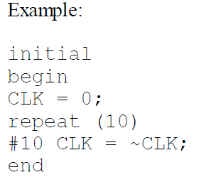

repeat Loops
A repeat loop provides a looping structure that will execute a fixed number of times. The following is the syntax for a Verilog repeat loop.
Example generates a clock signal (CLK) with a period of 10 time units to only produce 10 clock transitions, or 5 full periods of CLK.

Slide 15
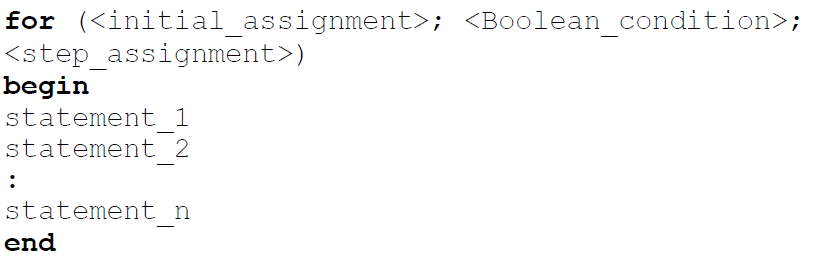
for Loops
A for loop provides the ability to create a loop that can automatically update an internal variable.
A loop variable within a for loop is altered each time through the loop according to a step assignment. The starting value of the loop variable is provided using an initial assignment. The loop will execute as long as a Boolean condition associated with the loop variable is TRUE.
The following is the syntax for a Verilog for loop:

Slide 16
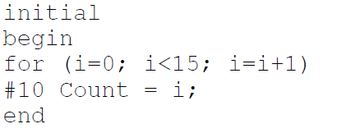
for Loops
The following is an example of creating a simple counter using the loop variable.
The loop variable i was declared as an integer prior to this block. The signal Count is also of type integer. The loop variable will start at 0 and increment by 1 each time through the loop. The loop will execute as long as i < 15, or 16 times total. For loops allow the loop variable to be used in signal assignments within the block.

Slide 17
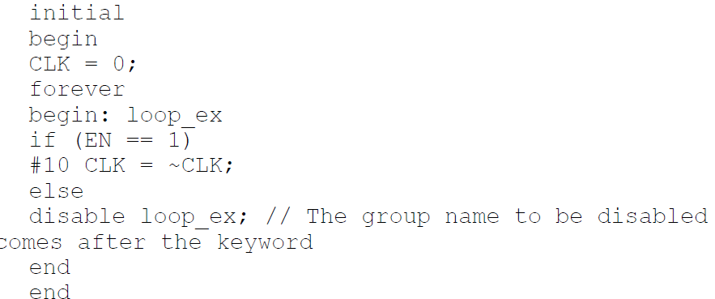
disable
Verilog provides the ability to stop a loop using the keyword disable. The disable function only works on named statement groups. The disable function is typically used after a certain fixed amount of time or within a conditional construct such as an if-else or case statement that is triggered by a control signal.
In given loop example that will generate a clock signal (CLK), but only when an enable (EN) is asserted. When EN = 0, the loop will disable and the simulation will end.

